Slide 1
GHLO
K-2 Spalding &
Singapore Night

Slide 2
Welcome to Spalding night, we are thrilled
that you are here!

Slide 3
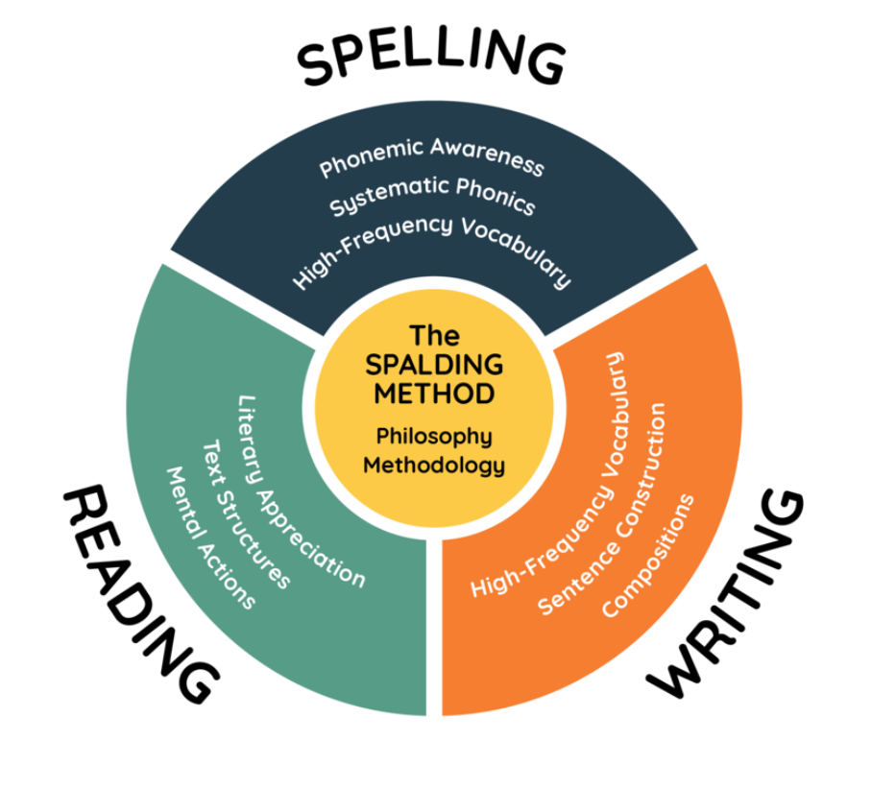
Why Spalding?
The Writing Road to Reading is a total language arts program that integrates essential research-based components, and educational philosophy, with a methodology consisting of time-tested principles.
It is this seamless blending of reading, spelling, and writing instruction that beautifully aligns with the classical approach, giving the proper emphasis to the Trivium’s Grammar stage.

Slide 4
Spalding Scope and Sequence
Each week students will learn new words Monday-Wednesday, review those words on Thursday, and be tested on those words every Friday.
Throughout the academic year, your child will cover a designated number of words from a universal source known as the Ayres list. This list is compiled of the most frequently used words in order of complexity.
While in lower school Spalding is taught sequentially, it is structured to proceed from the simple to the complex and is cumulative across all grade levels Kinder through 5th grade.

Slide 6
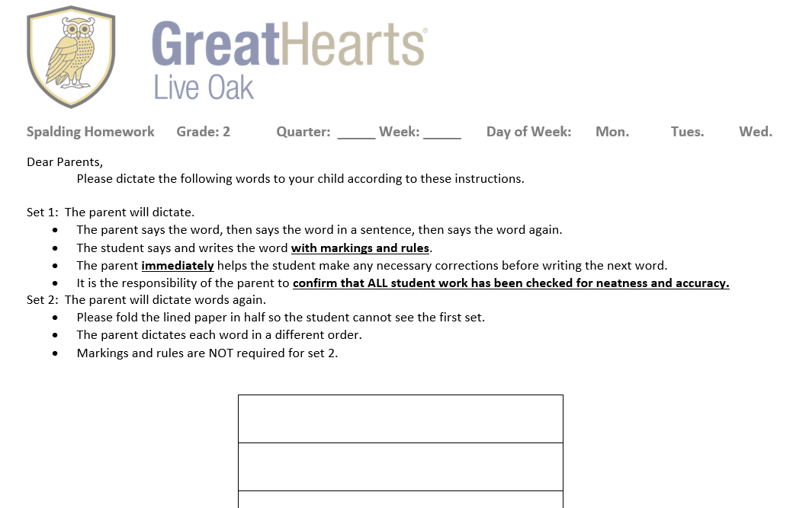
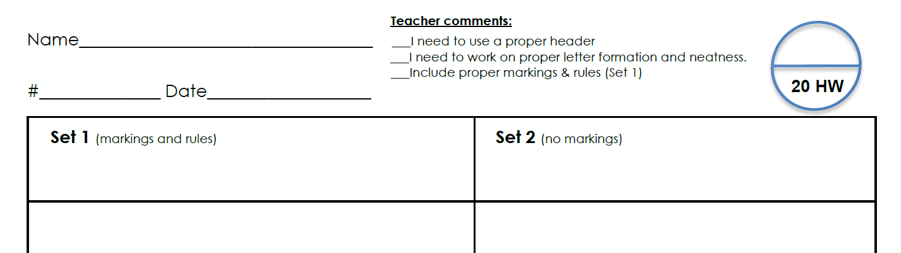
Homework
Expectations
Fidelity - Please follow the homework instructions.
Consistently - Regular practice produces the best results.
Homework Expectations

Slide 7
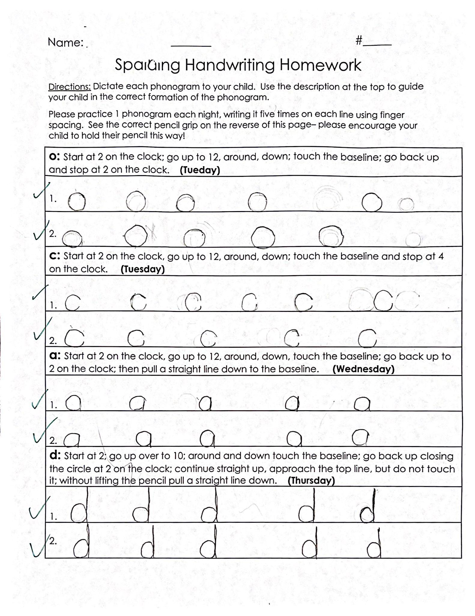
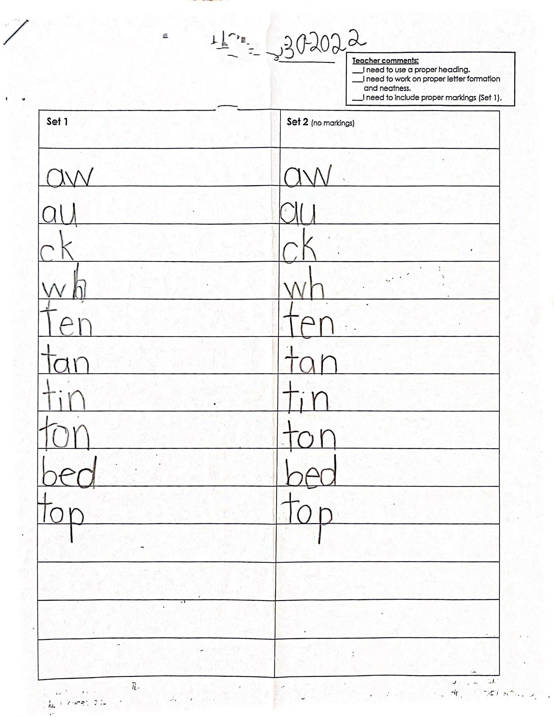
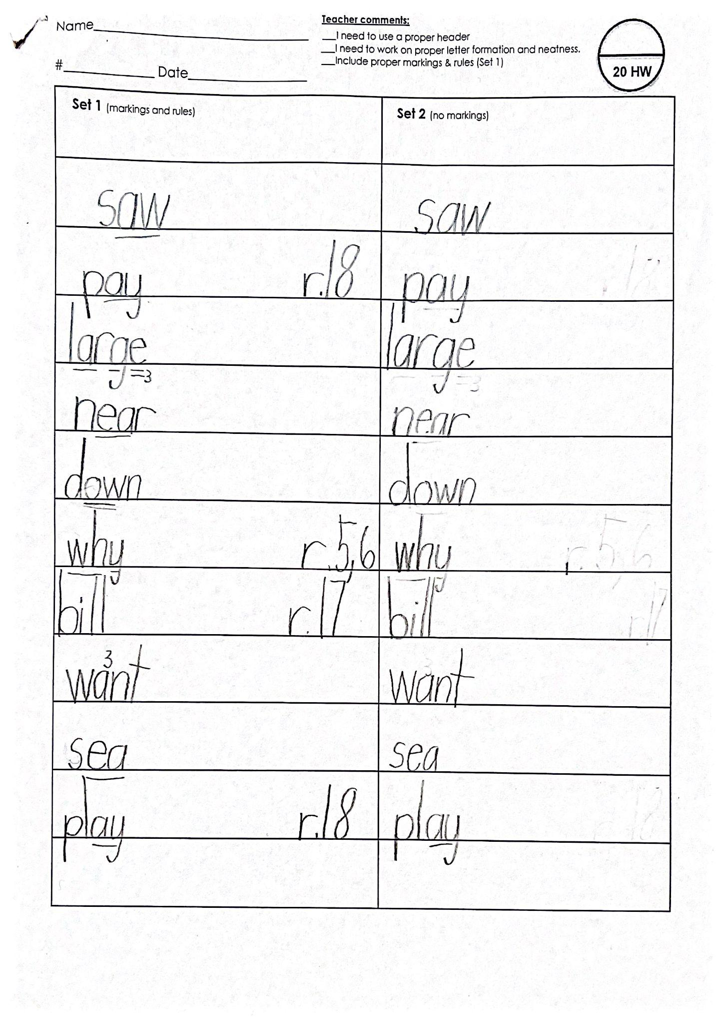
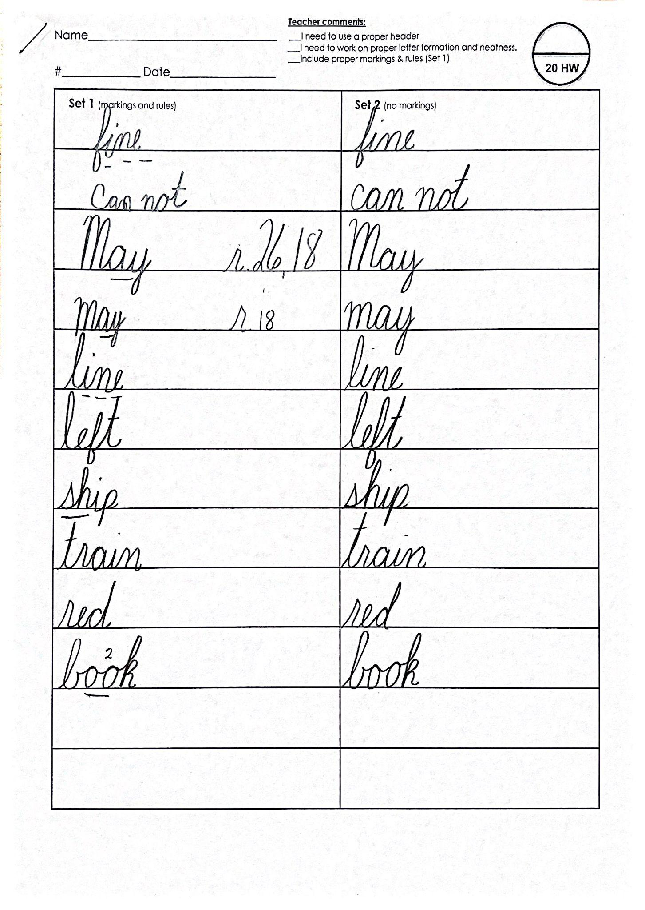
Spalding Homework

Slide 8
Homework Expectations
Homework Do’s
Do communicate with teachers early and often.
Do turn in homework on time.
Please make sure homework includes name, number, date, and markings on set one.
Homework Don'ts
Do not allow homework to become a wedge between you and your child. Tutoring, reteaching a skill or more practice in the classroom can avoid the struggle at home.
Do not wait to get help

Slide 9
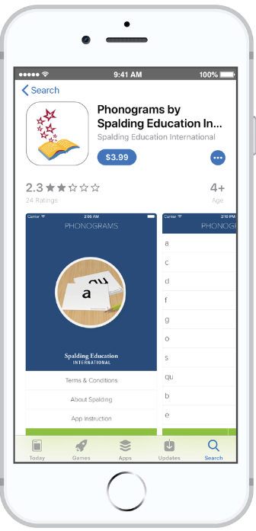
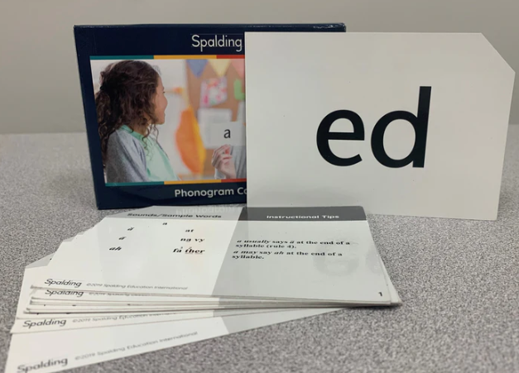
Take Home Materials
Pencil Grip
Letter formation
Phonogram Cheat Sheet
Markings reference guide
Homework Guide
Extra Spalding paper

Slide 10
Singapore time!
Take out your Model Drawing page and try the two word problems.
4 minutes

Slide 11
Why Singapore Math?
Everyone (especially every child) is a math person.
We use a Singapore Math curriculum because this teaching method increases the effectiveness and accessibility of math education for all of our students.

Slide 12
What is Distinctive about Singapore Math?
Covers fewer topics at greater depth
Mental math strategies are embedded in the program
De-emphasizes procedural skills
Emphasizes the development of good thinkers and problem solvers
Language-based program that helps children make connections between pictures, words, and numbers
Highly visual program that benefits students with varying needs

Slide 13
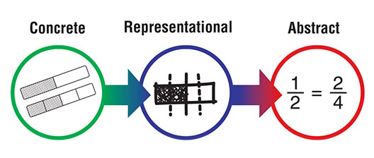
The C-P-A Method!
Pictorial

Slide 14
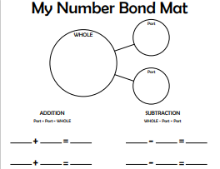
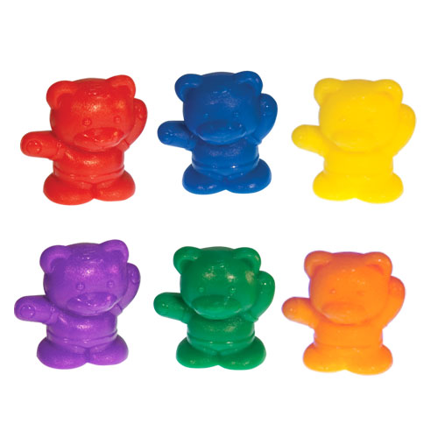
Concrete
Take out your bears and your number bond place mats.

Slide 15
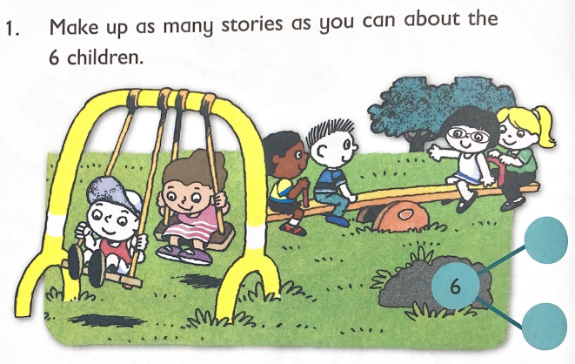
Pictorial

Slide 16
Abstract
5
6
?
6 - 5 = 1

Slide 17
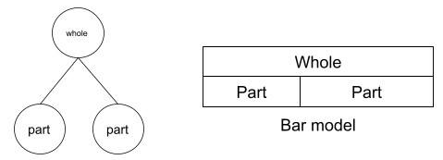
Bar Models!

Slide 18
Place Value Chip Demonstration

Slide 19
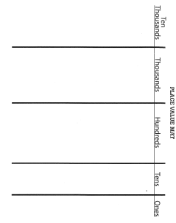
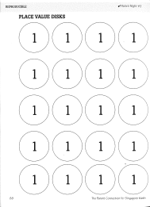
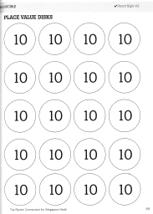
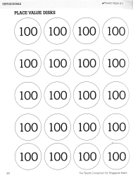
Take Home Materials
K-2 Model Drawing
Number Bond Place Mat
Number Bond Place Mat x4
Place Value Place Mat
How Parents Can Help at Home
Digital copies of these resources will be sent to you via email along with a resource for printing your own place value chips.

Slide 20
Parent-Student Connection
Have math discussions with your child. Find real-world situations in which to practice math and to do mental math together.

Slide 21
Parent-Student Connection
Be curious
Listen to your child explain how he figured out a problem.
Ask your child to teach you how to solve problems or do computation using some of these new strategies she is learning at school.
Ask questions like, “What is your favorite method for solving? What did you learn from a mistake you made today?”

Slide 22
Parent-Student Connection
When a child is struggling or stuck with math homework, try using objects or drawings to help the student visualize the math.
If you or your student reach a point of frustration, stop for the night.
Don’t tell your children you weren’t good at math.
Notes:
Math homework is an opportunity to review and practice skills and concepts taught in class. This time to review and practice is necessary for students to succeed in math class. Kinder students begin math homework later in the year.

Slide 23
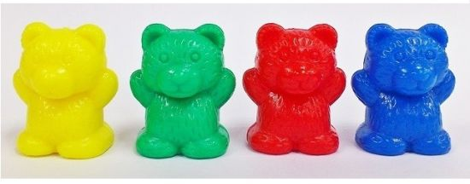
Thank you parents!
Do not take home the bears.

